Slide 1














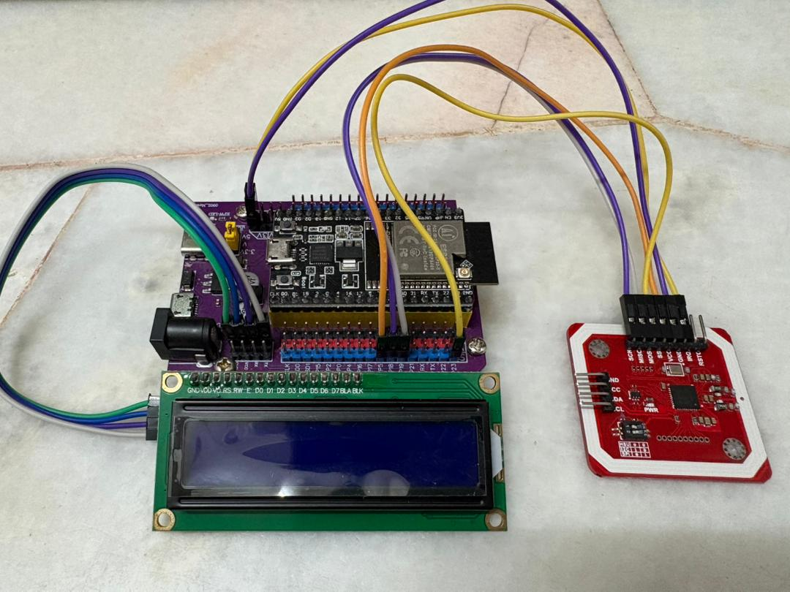

















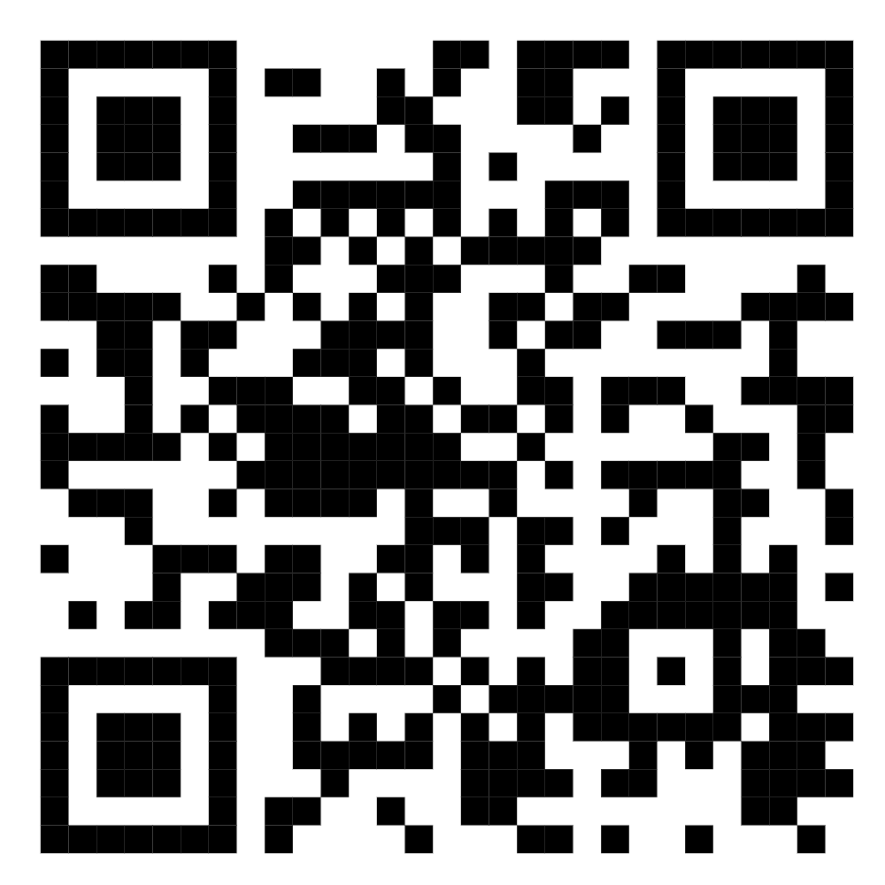
NFCAMPUS
A DIGITAL STUDENT IDENTIFICATION & ACCESS SYSTEM USING NFC TECHNOLOGY FOR ANDROID
Eu Jin Yang jin.eu@students.plymouth.ac.uk
Ng Kean Chun kean.c.ng@students.plymouth.ac.uk
Teoh Yi Shan yi.teoh@students.plymouth.ac.uk
Yong Ken ken.yong@students.plymouth.ac.uk
BACKGROUND & PROBLEM STATEMENT
IMPLEMENTATION PLAN
KEY FEATURES
Our college uses RFID access cards for entry into campus buildings, libraries, and labs.
Module 1: Basic Foundations
Develop a backend server, database, and basic API endpoints
Build an Android app with a login system, user interface and navigation
User Authentication: Email and password login system
OCR Integration: Automatic card scanning
NFC UID Binding:
Secure card-to-account linking
PROBLEM
SOLUTION
HCE Technology: Smartphone card emulation
Cloud Backend: Firebase-powered data management
Secure Storage: Encrypted credential protection
Module 2: Core Features
OCR registration flow, NFC UID capture
Password and email login, one-card-per-account system
VS
PROJECT TIMELINE
While effective, this system has a major flaw: “It relies solely on a physical card”.
Students are frequently locked out due to forgotten, lost, or damaged cards
Leading to missed classes, exams, and significant frustration.
The core issue is that the system identifies the card, not the person.
Our solution leverages NFC technology on smartphones
Creating a digital credential that integrates access control into a device students always carry.
Module 3: HCE Integration
Implement HCE service to emulate card’s UID
Integrate “Simulate Access” feature
Phase 0: Initial Setup & Exploration
Timeline: Sept 2025
Environment setup (Android Studio, GitHub)
POC: Read NFC UID on test device
Requirement gathering & stakeholder interviews
Phase 1: Research & Proposal
Timeline: Sept – Oct 2025
Literature review & competitive analysis
Define scope, SMART objectives & methodology
Proposal writing, review & submission
OBJECTIVES
Module 4: Testing & Polishing
End-to-end testing, security auditing
User testing, documentation
Develop a secure and reliable smartphone-based authentication system that supplements the existing college access card system.
Phase 2: System Design & Architecture
Timeline: Oct – Nov 2025
System architecture & module planning
UI/UX wireframes (Figma)
Database schema & NFC/OCR flow design
Phase 3: Core Feature Development
Timeline: Nov – Dec 2025
Login & registration module
OCR for student ID
NFC UID binding & login
SMART Criteria:
ESP32 with Expansion Board
Specific
Develop a functional mobile application prototype that can emulate the college access card’s credentials through NFC
PN532 (SPI)
Phase 4: HCE Integration & Prototype
Timeline: Jan – Feb 2026
Host Card Emulation (HCE) implementation
Simulated access / demo functionality
Prototype validation
Phase 5: Testing & Improvements
Timeline: Feb – Mar 2026
Unit, integration & security testing
Usability testing & performance tuning
Bug fixes & refinements
Measurable
Prototype should successfully interact with test reader and trigger the “unlock” signal
Achievable
Use Android Studio and Host Card Emulation (HCE) for Android phones
Relevant
Provides a practical, modern supplement to the existing card system
LCD Display (I2C)
Phase 6: Documentation & Final Submission
Timeline: Mar 2026
Update documentation
Final report & documentation
Demo, presentation & submission
Time-Bound
Project deadline: 28th March 2026
TESTING & EVALUATION
METHODOLOGY
Unit Testing
Test each part of the system (e.g., Login, NFC Scan, Database)
Make sure every module works properly before integration
Integration Testing
Combine all modules and test how they work together
Check communication between the app, server, and NFC reader
EXPECTED DELIVERABLES
Framework:
Agile-Scrum approach with iterative development
Sprints
Two-week development cycles
Category | Deliverable
Application | Fully functional Android app with OCR, NFC, and HCE
Backend | Firebase system with user accounts and UID validation
Documentation | System design, UML diagrams, API documentation
Testing | Test plans, reports, and security audits
Presentation | Final slides, demo video, project report
Sprint Planning
Persistent hemolysis markers
Security Testing
Check how well the system protects user data and access
Test for unauthorized access, NFC cloning, and encryption
System Testing
Test the full system in real-world scenarios
Try cases like valid/invalid users, lost devices, and no internet
Daily Stand-ups
Synchronize activities and identify blockers
EXPECTED OUTCOME & SIGNIFICANCE
Sprint Review
Demonstrate completed functionality
Usability Testing
Let students use the app and give feedback
Measure ease of use, speed, and satisfaction
Performance Evaluation
Evaluate the system’s speed and reliability under heavy use
Simulate multiple users and long usage periods
Anticipated Results:
A fully functional Android application
Seamless NFC-based access control
Enhanced security model
Contributions:
Academic: Advancement in mobile computing and security
Industrial: Modernization of campus infrastructure
Societal: Enhanced user convenience and inclusivity
Beneficiaries: Students and the academic institution
Retrospective
Process improvement and refinement
Android
Studio
Firebase
Cloud
Firestore
Kotlin
Node.js
Javascript
GitHub
Figma
SCAN HERE FOR REFRENCES

